Slide 1
Industry Canada
Strategis ic.gc.ca
2
WEEK
MKTG2341-09 PC Lab 2

Slide 2

Industry Canada’s Reports
Industry Canada issues industry statistics and reports on specific sectors.
We will find industry statistics on the Canadian Wine Industry.
MKTG2341 PC Lab 2

Slide 3


Government Business Statistics
Strategis is Industry Canada’s portal to business information and includes industry, trade, market, directory and consumer information.
Has merged with Industry Canada portal.
Notes:
Another reputable source of information is the government:
The government is a top source of high quality information. Industry reports include a great deal of market information, including statistics.
DEMO THIS:
Strategis.gc.ca
Business Information by Sector
B
Beverage Industry – Agriculture
Agriculture
Statistics, Analysis & Industry Profiles (left hand side)
Industry Profiles
NAICS 3121 - Beverage Manufacturing (center of the page)
31213 – Wineries (left hand side)
left side table of content of all the stats and reports.
Ex click on: Establishments
first definitions, then at the bottom of the page stats.

Slide 4
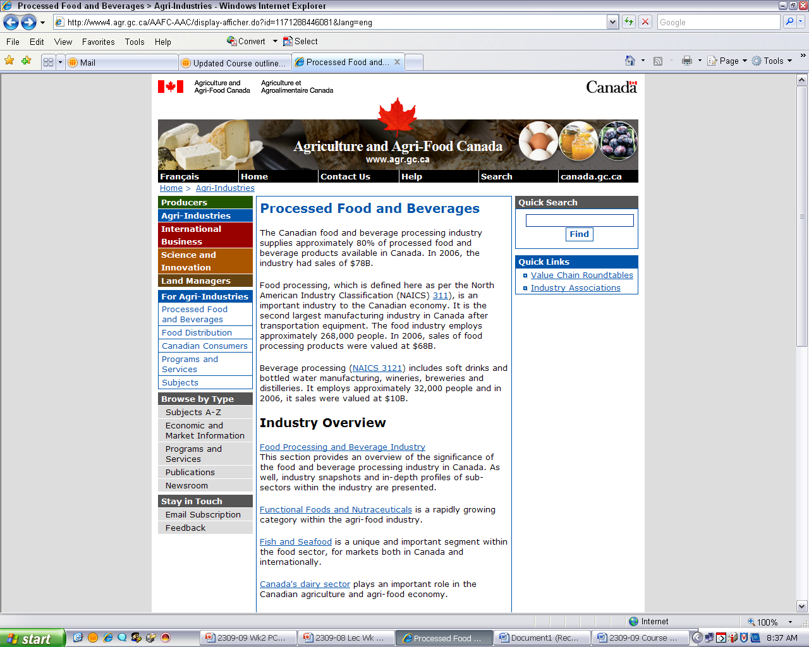
MKTG2309 PC Lab 3

Slide 5
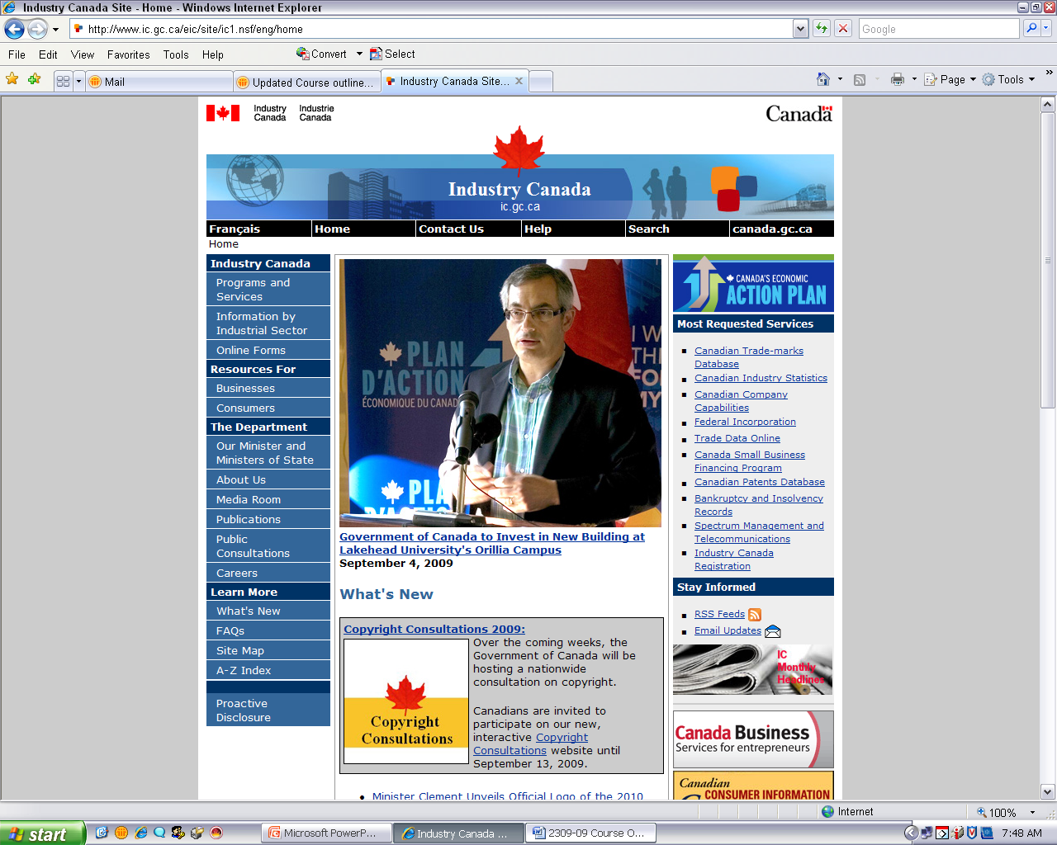
Start here
MKTG2309 PC Lab 3

Slide 6
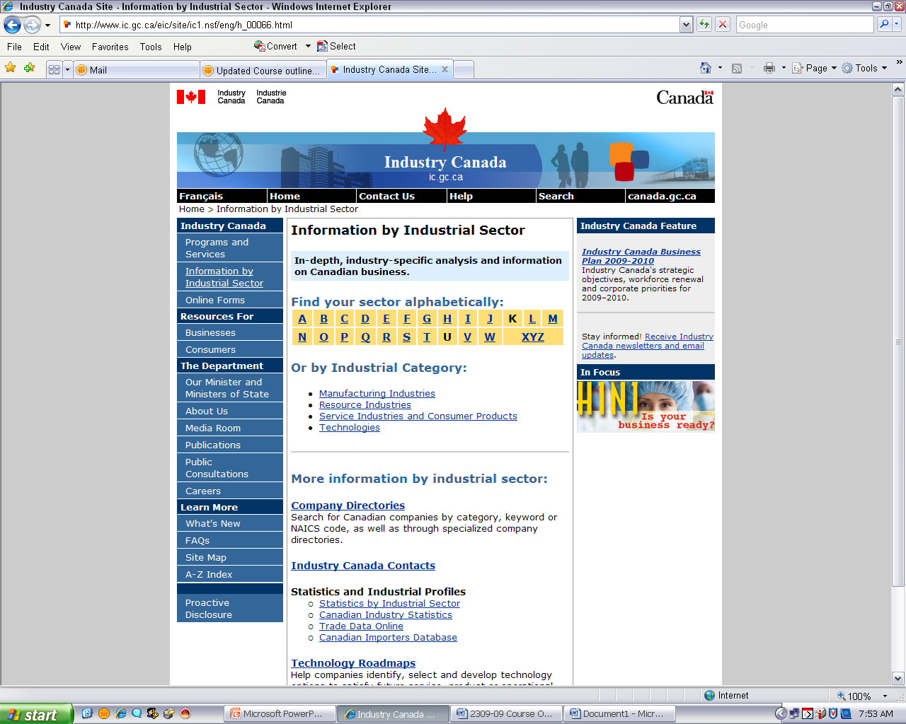
Click on ‘B’ for Beverage
MKTG2309 PC Lab 3

Slide 7
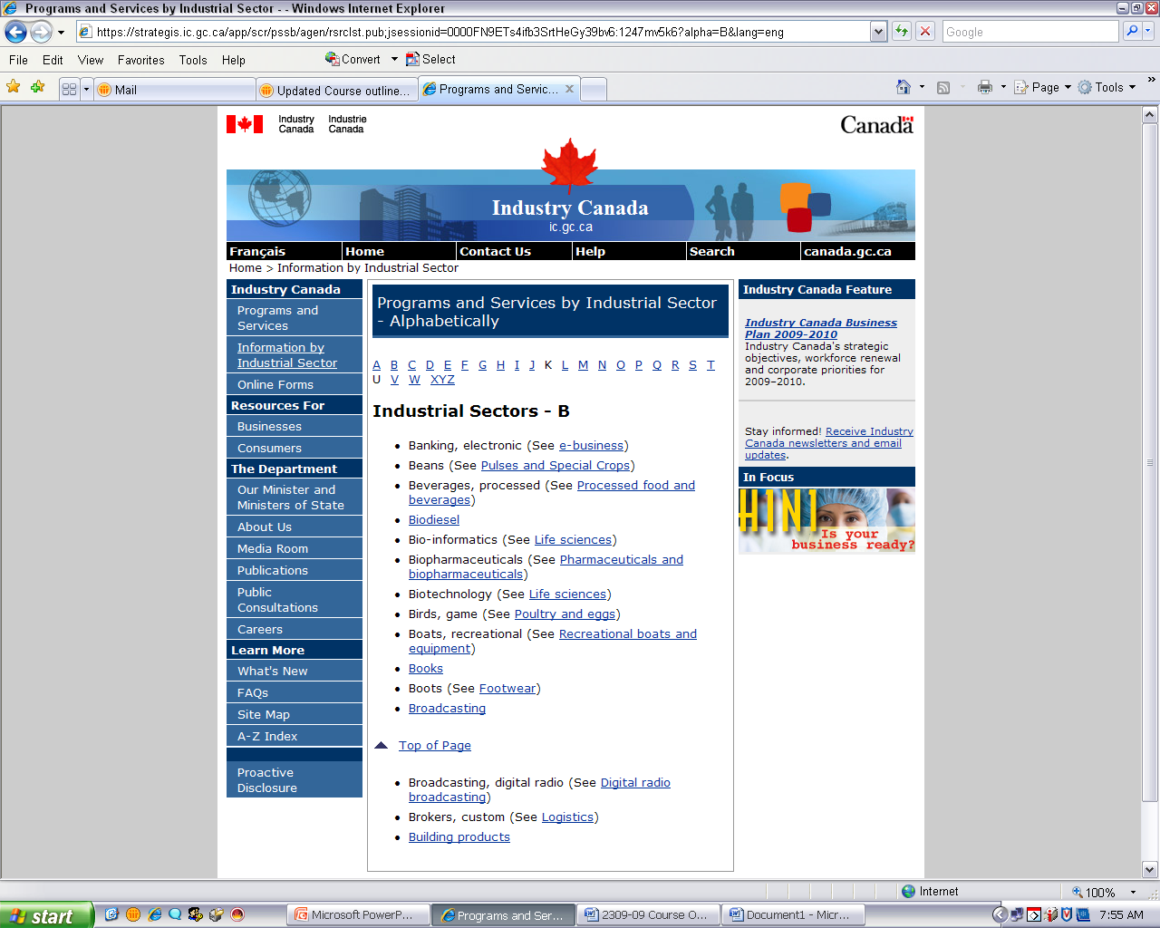
Then click on this link.
MKTG2309 PC Lab 3

Slide 8
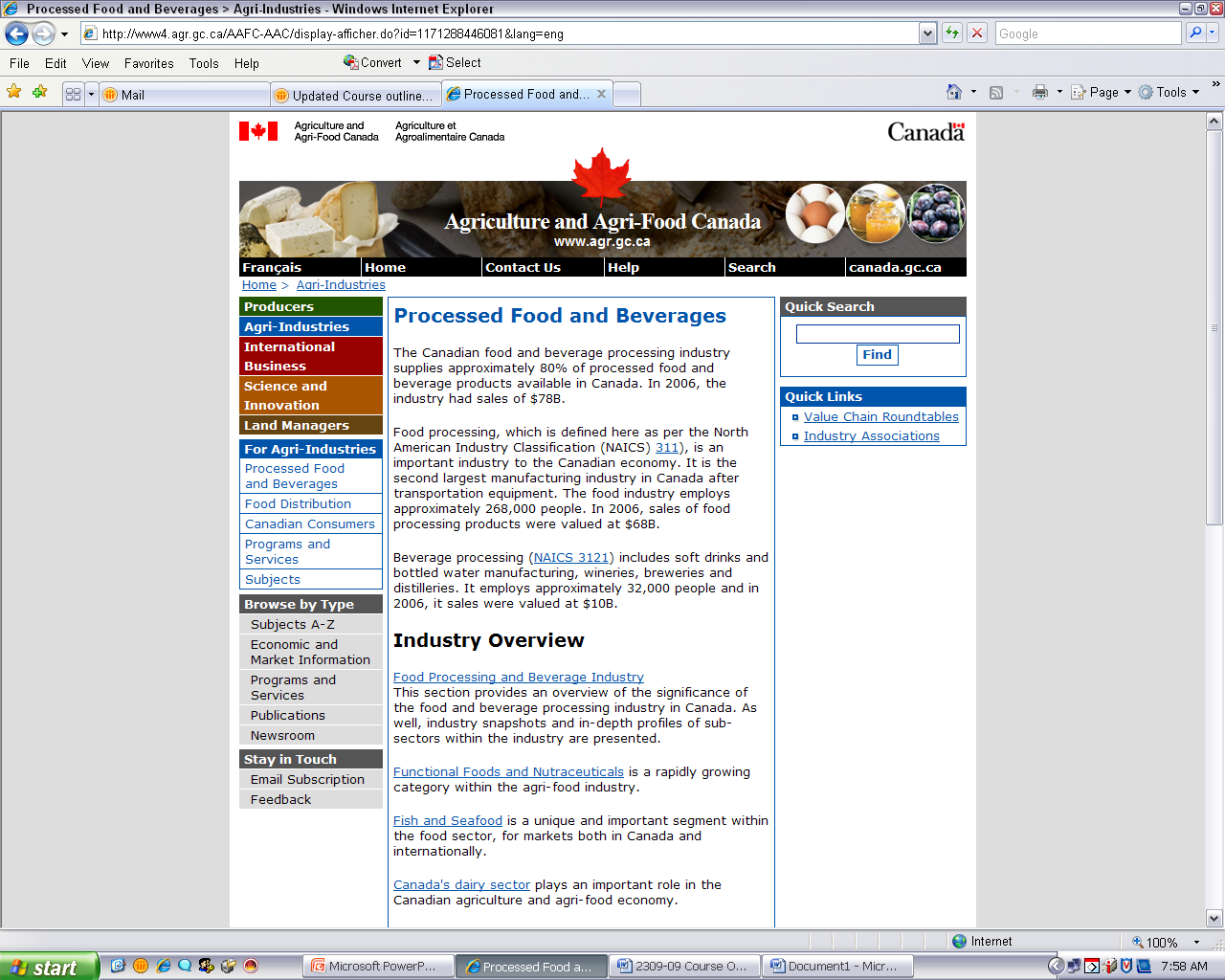
Scroll down to find the ‘Statistics’ Section
MKTG2309 PC Lab 3

Slide 9
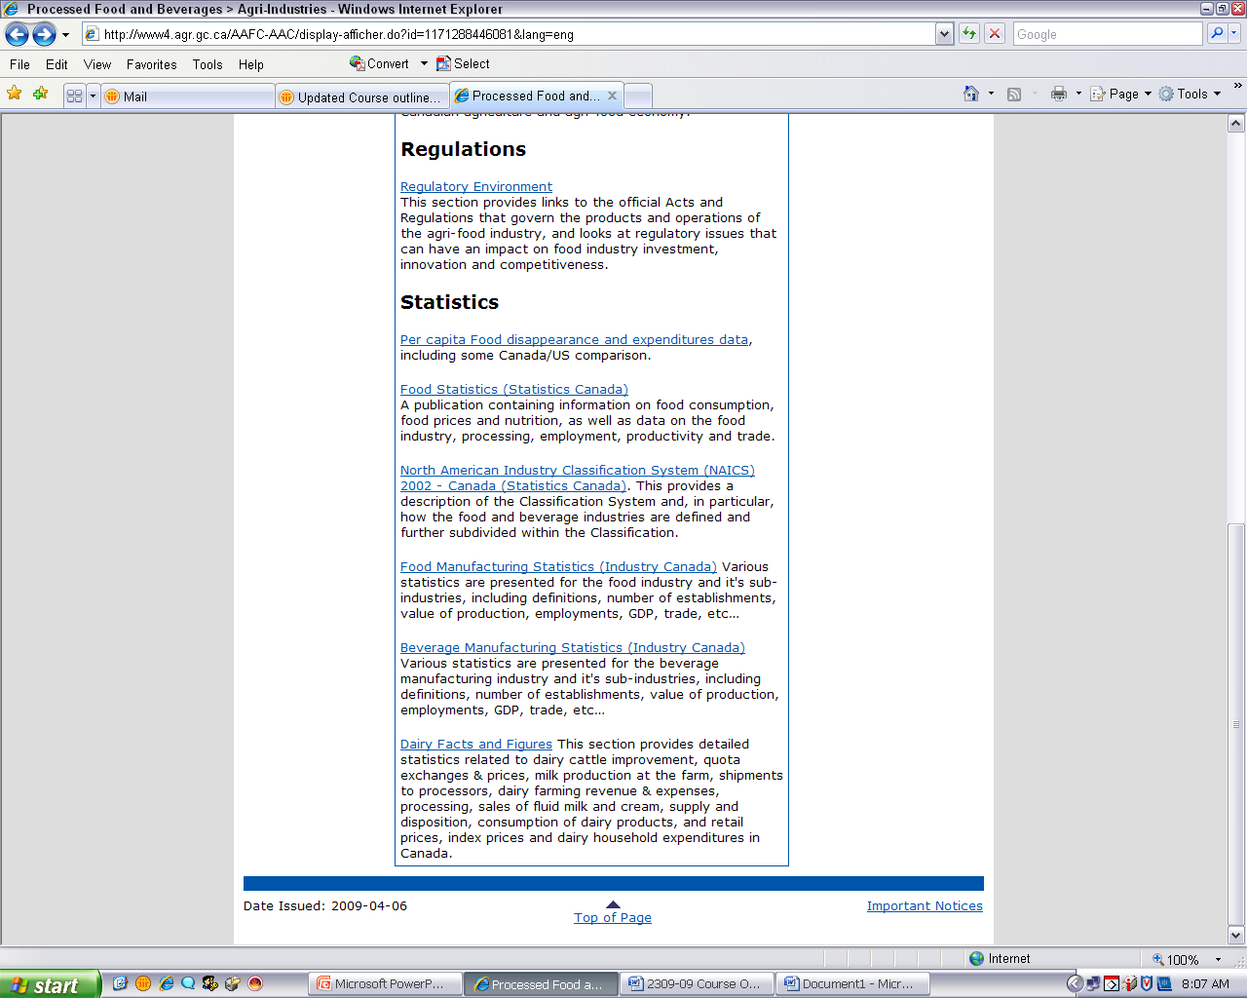
MKTG2309 PC Lab 3

Slide 10
This will take us to information about the overall Beverage Industry in Canada, of which Wineries are a part.
To get information specific to the Wine Industry, we have to narrow our search using the appropriate North American Industry Classification System (NAICS) code.
MKTG2309 PC Lab 2

Slide 11
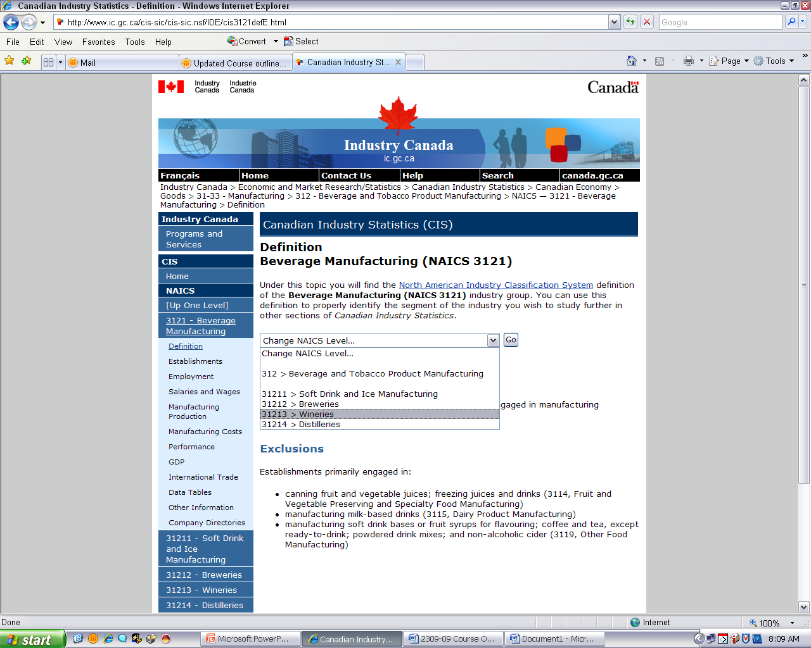
Click here
Then click here
MKTG2309 PC Lab 3

Slide 12
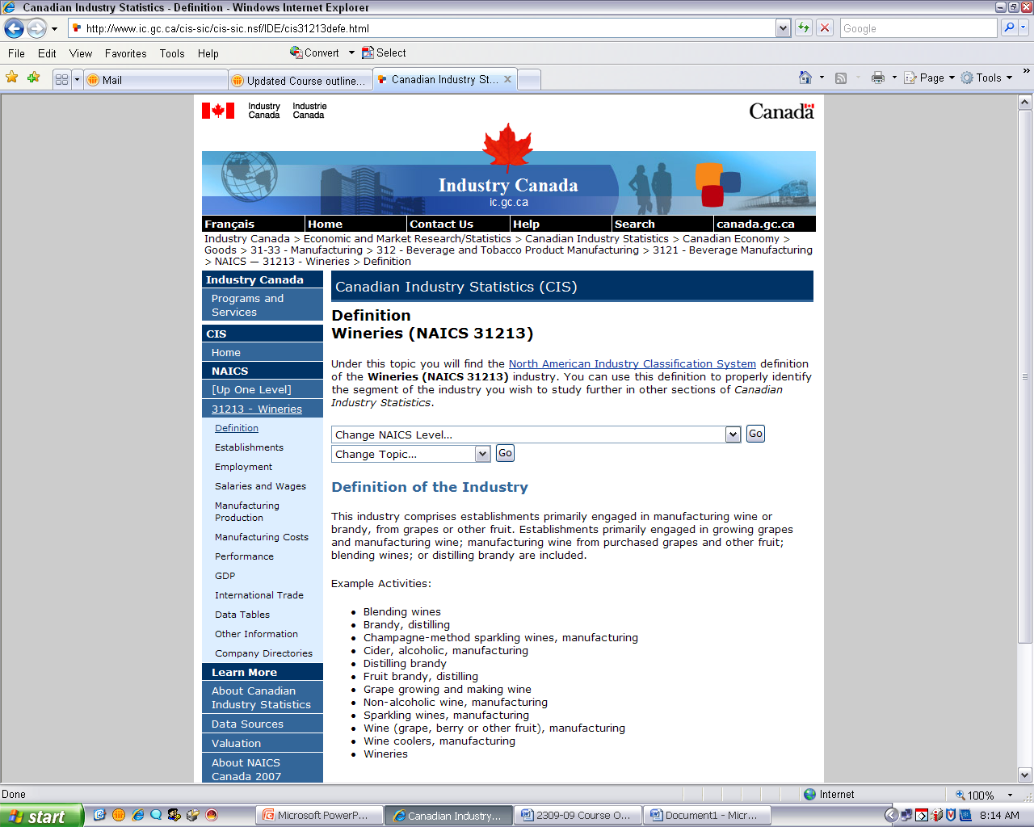
Now we’re looking at information for the Winery Industry in Canada and we can choose from all of these different topic options.
MKTG2309 PC Lab 3

Slide 13
Choose “Employment”.
MKTG2309 PC Lab 3

Slide 14
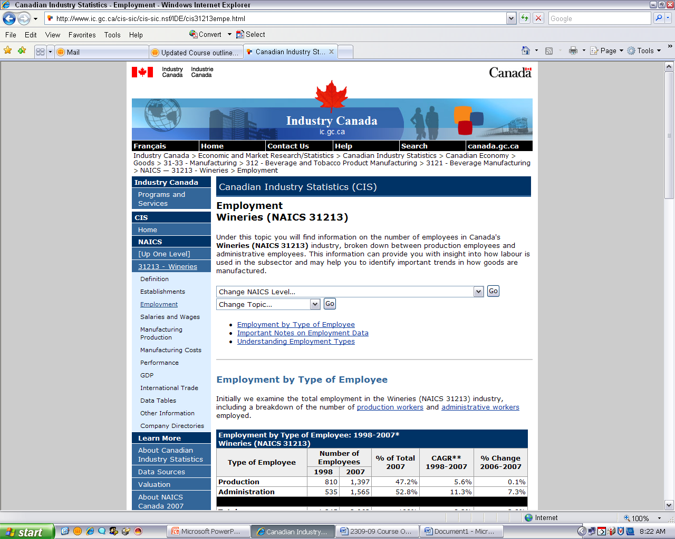
Scroll down to see the different types of employment-related information provided
MKTG2309 PC Lab 3

Slide 15
OVER TO YOU…
Practice your search skills on the Industry Canada website using the tools that you have been shown.
Choose an industry that you are interested in and find salary and wage information for it.
Remember to use the NAICS codes to help you find the right industry!
Let me know when you’ve found what you’re looking for.

